Slide 1
Learning Objective
I will be able to determine the rules of logarithms functions.
Success Criteria
At the end of the lesson, I will be able to:
4.1.7 Solve simple equations involving logarithmic functions algebraically and graphically

Slide 2
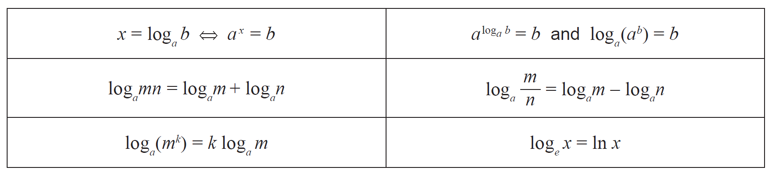






Laws of logarithm
In the formula sheet:
Inverse relationship between log and exponentials:
Law 7:
Law 1:
Law 2:
Natural logarithm:
Law 3:
Not in formula sheet:
Law 4: $\log_{a}{a=1}$
Law 5: $\log_{a}{1=0}$
Law 6: $\log_{a}{\frac{1}{x}}=−\log_{a}{x}$
$$\log_{a}\left(a^{x}\right)=x$$
Change of Base: $\log_{a}{b}=\frac{\log_{c}{b}}{\log_{c}{a}}$
$$a^{\log_{a}{x}}=x$$

Slide 3



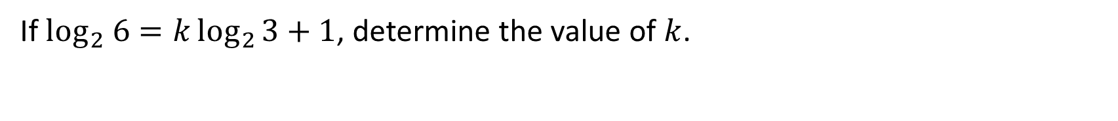




Guided Practice
If $\log_{2} 6=k\log_{2}{3}+1$, determine the value of $k$.
$$\log_{2}{6}=k\log_{2}{3}+1$$
$$\left(1=\log_{2}{2}\right)$$
$$\log_{2}{6}=\log_{2}{3^{k}}+\log_{2}{2}$$
$$\log_{2}{6}=\log_{2}{(3^{k}}×2)$$
$$6=2×3^{k}$$
$$3^{k}=3$$
$$∴k=1$$

Slide 4





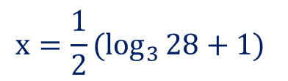


Guided Practice
Solve for $x$ if $2^{x}=11$, expressing the answer to two decimal places.
$$2^{x}=11$$
$$x=\log_{2}{11}$$
$$x≈3.46 (2 d.p)$$
Solve for $x$ if $3^{2x−1}=28$, expressing the answer to three decimal places (showing all working).
$$3^{2x−1}=28$$
$$\log_{3}{28}=2x−1$$
$$\log_{3}{28}+1=2x$$
$$x=\frac{1}{2}(\log_{3}{28}+1)$$
$$x≈2.017 (3.d.p)$$

Slide 5

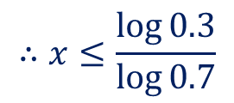


Guided Practice
Solve the inequality ${0.7}^{x}≥0.3$ (in terms of $\log_{10}{ }$)
$$\log_{ }{{0.7}^{x}}≥\log{0.3}$$
$$x\log{0.7 }≥\log{0.3}$$
Note: $\log{0.7}<0$
$$∴x≤\frac{\log{0.3}}{\log{0.7}}$$

Slide 6
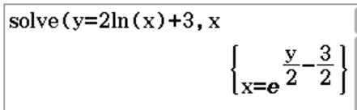


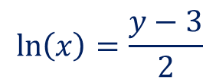

Guided Practice
Rewrite the equation $y=2\ln{(x)}+3$ with $x$ as the subject
$$y=2\ln{(x)}+3$$
$$2\ln\left(x\right)=y−3$$
$$\ln\left(x\right)=\frac{y−3}{2}$$
$$x=e^{\frac{y−3}{2}}$$

Slide 7



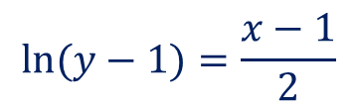

Guided Practice
Rearrange the equation $x=2\ln\left(y−1\right)+3$ to express $y$ as a function of $x$.
$$x=2\ln{(y−1)}+3$$
$$2\ln{(y−1)}=x−1$$
$$\ln{(y−1)}=\frac{x−1}{2}$$
$$y−1=e^{\frac{x−1}{2}}$$
$$y=e^{\frac{x−1}{2}}+1$$

Slide 8


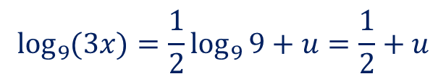
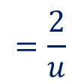
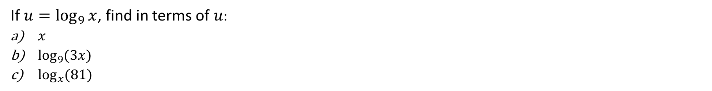

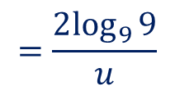

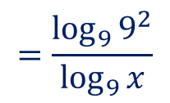


Guided Practice
If $u=\log_{9}{x}$, find in terms of $u$:
$x$
$\log_{9}{(3x)}$
$\log_{x}{(81)}$
a) $u=\log_{9}{x}$
$$x=9^{u}$$
b) $\log_{9}{(3x)}=\log_{9}{3}+\log_{9}{x}$
$$\log_{9}{(3x)}=\log_{9}{9^{\frac{1}{2}}}+u$$
$$\log_{9}{(3x)}=\frac{1}{2}\log_{9}{9}+u=\frac{1}{2}+u$$
c) $\log_{x}{(81)}=\frac{\log_{9}{81}}{\log_{9}{x}}$
Change of Base: $\log_{a}{b}=\frac{\log_{c}{b}}{\log_{c}{a}}$
$$=\frac{\log_{9}{9^{2}}}{\log_{9}{x}}$$
$$=\frac{2\log_{9}{9}}{u}$$
$$=\frac{2}{u}$$

Slide 9
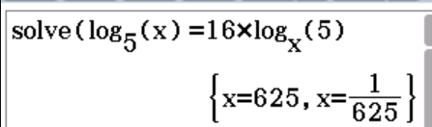





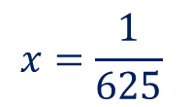
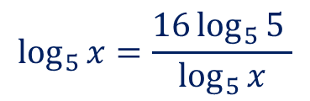

Guided Practice
Solve the equation $\log_{5}{x}=16\log_{x}{5}$
$$\log_{5}{x}=16\log_{x}{5}$$
$$\log_{5}{x}=\frac{16\log_{5}{5^{ }}}{\log_{5}{x}}$$
$${\left(\log_{5}{x}\right)}^{2}=16$$
$$\log_{5}{x}=4, \log_{5}{x}=−4$$
$$x=5^{4}$$
$$x=5^{−4}$$
$$x=625$$
$$x=\frac{1}{625}$$

Slide 10
Independent Practice
Complete Ex 2G + JKlup worksheet

